Slide 1
HKCA Electronic portfolio system
https://www.hkca.edu.hk/eps

Slide 2
WHAT YOU NEED TO KNOW…
As a Trainer
As a SOT
As a Trainee

Slide 3
WHAT YOU NEED TO KNOW…
As a Trainer
Please use your College website login ID and password for this electronic portfolio system. The login ID should be your correspondence email address with the College. If you forgot the password, please reset your password at http://www.hkca.edu.hk/member/login.php
You can change your password after you log into the electronic portfolio system, under the session "My Profile" on the title bar
As a Trainee
As a SOT

Slide 4
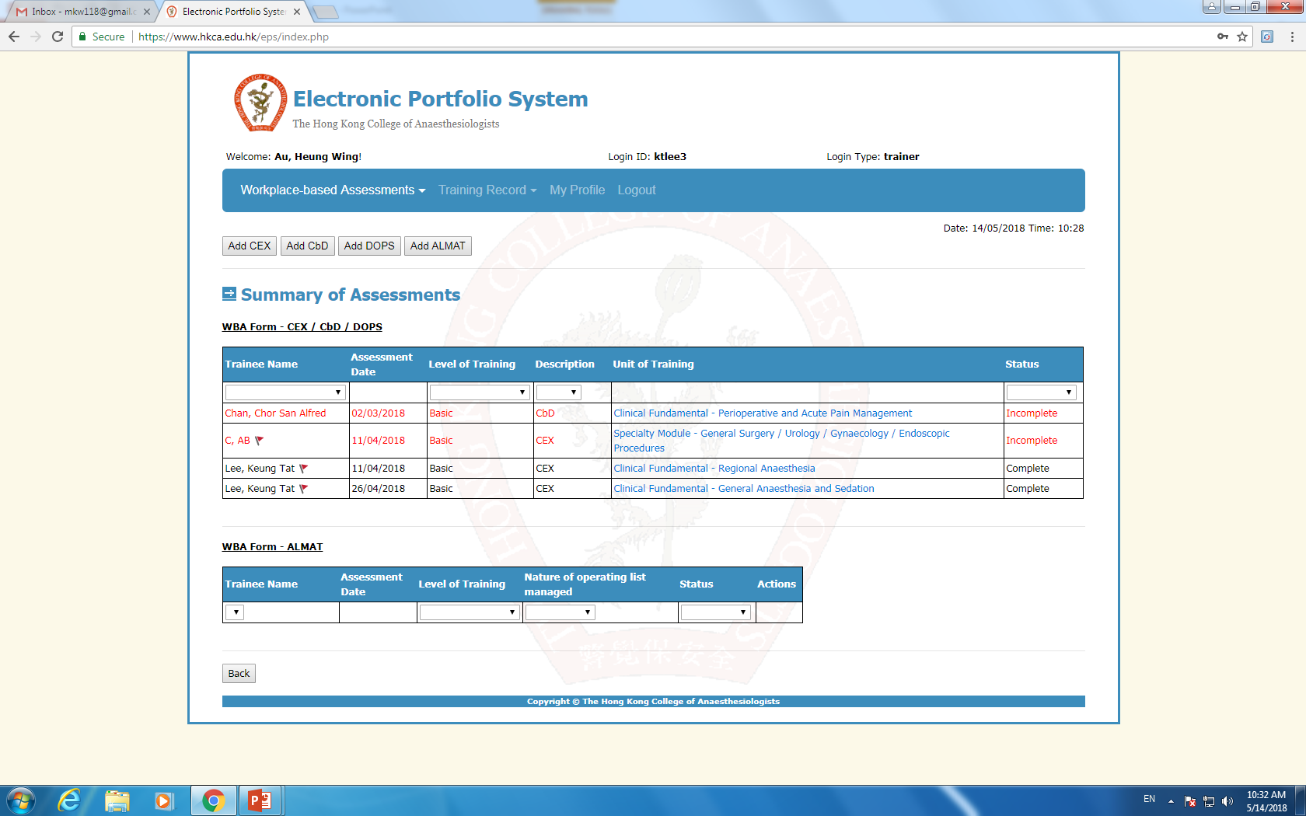
Trainer
Chan, Tai Man
Chan, Peter
Notes:
Trainees initiate the WBA process. A trainer will be approached for WBA
Trainer can select to add a WBA form (RED arrow)
The table below shows the WBA you have done for trainees. There can be multiple trainee records in this table in sequential order
You can sort the table according to (1) trainee’s name, (2) level of training, (3) type of WBA, (4) whether the WBA is complete or incomplete (both trainees and trainers have to sign to complete a WBA form)
For the ease of recognition, incomplete forms are in red, completed forms are in black
The mark (in red circle) allows you to easily identify those forms that you want to review later, if needed

Slide 5
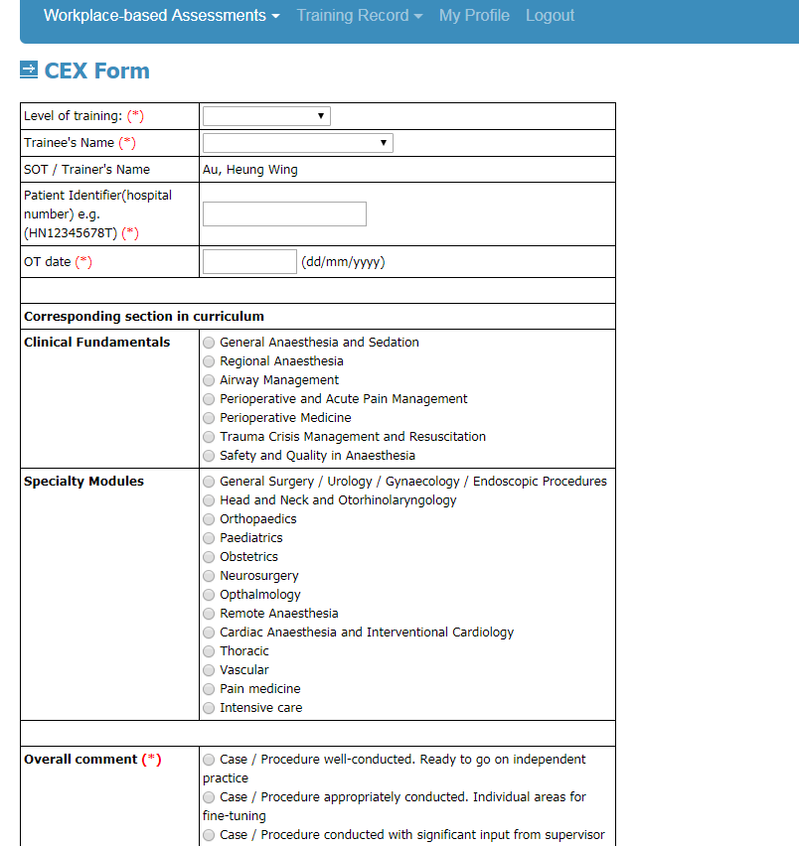
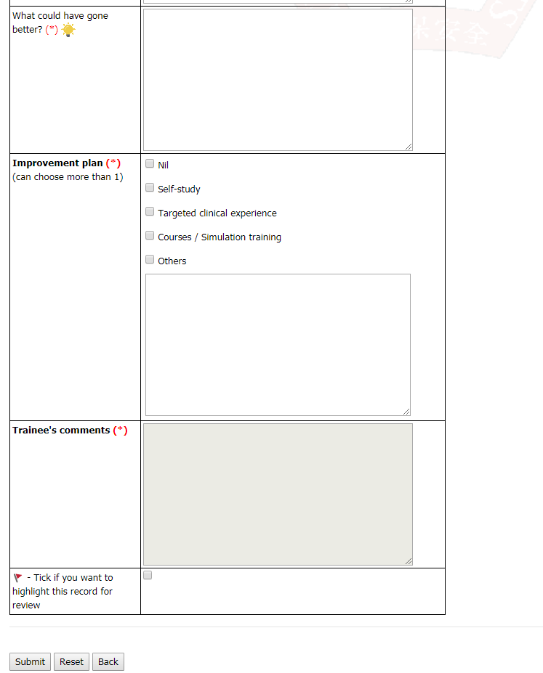
Notes:
Please enter 1 item each time (for BOTH CEX, CbD and DOPS form)
It is possible to use more than 1 assessment tools at one WBA occasion. For example, in a patient for Caesarean section under GA, the trainer can assess the intubation skill (DOPS) and the anaesthetic management (CEX) in the same patient
Officially, there is no maximum number of WBA allowed in each single episode. However, to ensure the quality of WBA, the trainer and trainee should limit the number of WBA to a reasonably manageable number in each single episode, say not more than 3
While a trainee is allowed to have more than 1 WBA on the same patient, he/she can only enter the WBA in 1 specialty module. For example, a CEX done in a paediatric patient having an eye operation, the trainee can enter the CEX under paedi or eye module, but NOT BOTH.
So far, the system has not been developed and advanced to suit the rules
You are encouraged to put down your comments in the box provided. The yellow lightbulb gives you some topics or areas that you can comment on a trainee’s performance
If you want to review this form again, you can check the box at the bottom of the page (RED CIRCLE) for easy identification in the summary table
After you submit the form, the form will appear on the summary table, a trainer can always click into it for review. A trainer is free to amend anything before the trainee signs and completes the form. Once the trainee signs and completes the form, the form is locked by the College admin

Slide 6
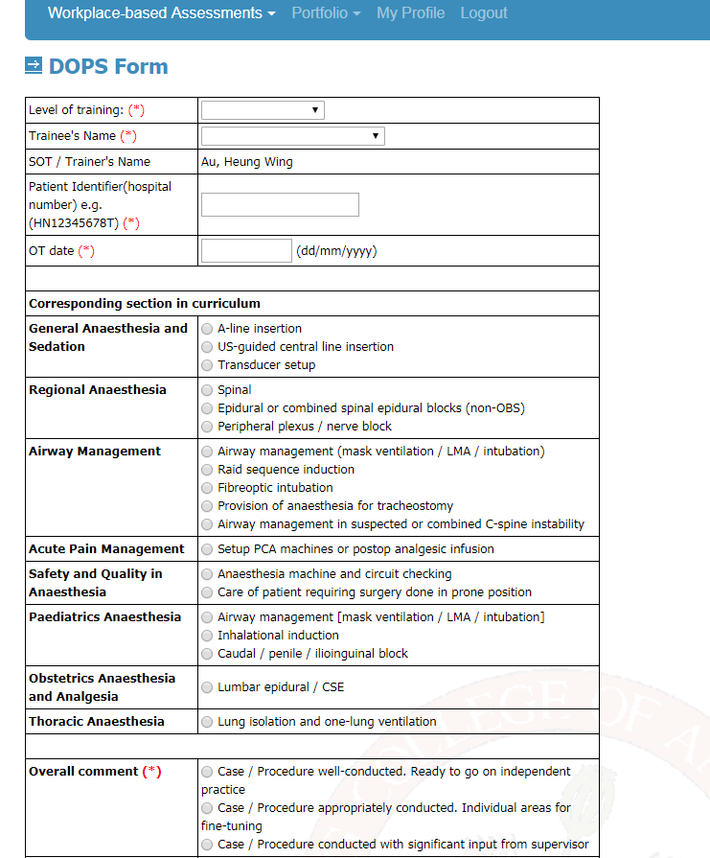
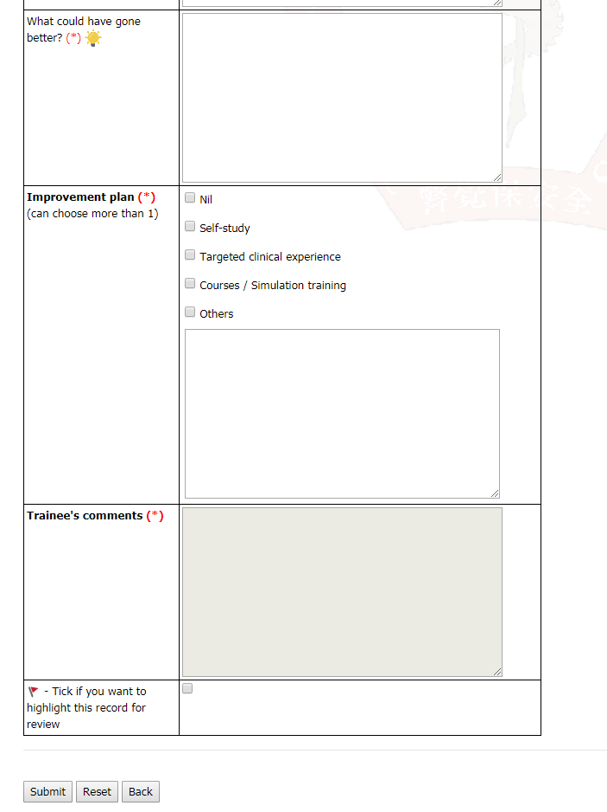
Notes:
The CbD form is the same as the CEX form
The DOPS form has a similar layout
The rules still apply: it is recommended to limit the number of WBA is a single patient to <=3

Slide 7
WHAT YOU NEED TO KNOW…
As a Trainer
As a Trainee
  Login ID and Password according to the individual trainee
As a SOT

Slide 8
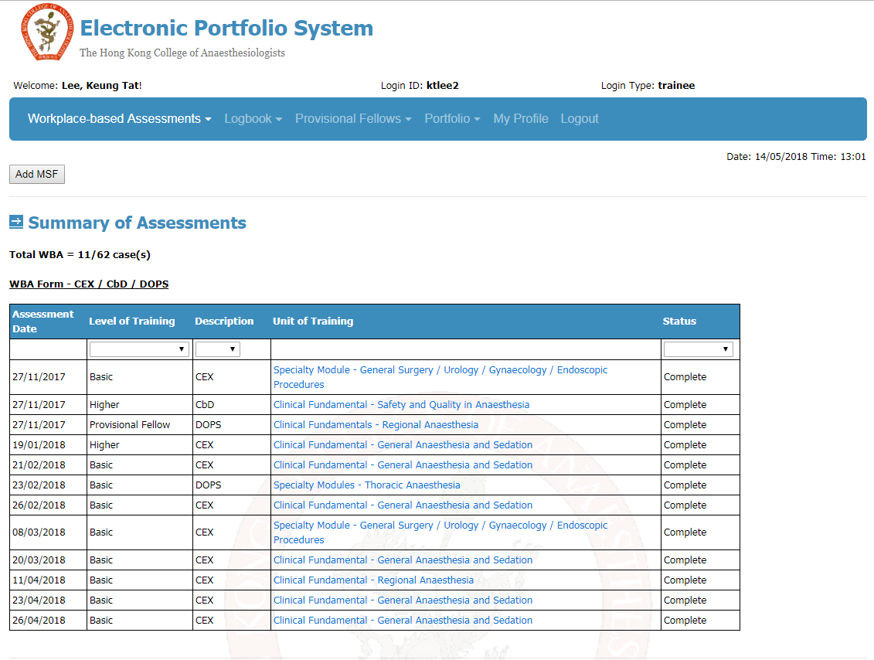
trainee
Notes:
For trainee’s account, the table shows all the WBA he/she did in time sequence. Again you can sort the table in (1) level of training, (2) types of WBA, (3) whether it is complete or not
Trainees can also click into individual WBA form to review the record. A trainee needs to submit the WBA form as well in order to complete the record. Once completed, the form is locked and cannot be further modified
There is a count as shown in the RED BOX. One needs a total of 62 WBA throughout 6 years. A trainee can keep track of the number of WBA done

Slide 9
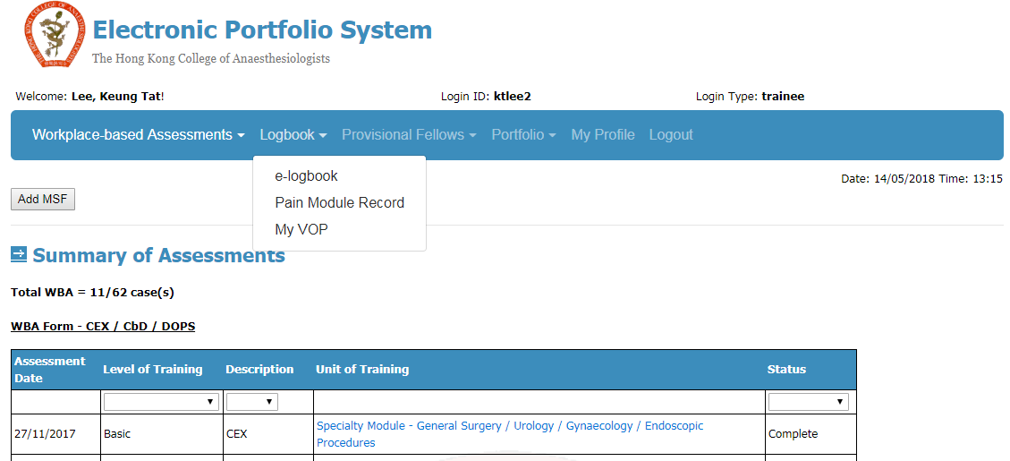

Slide 10
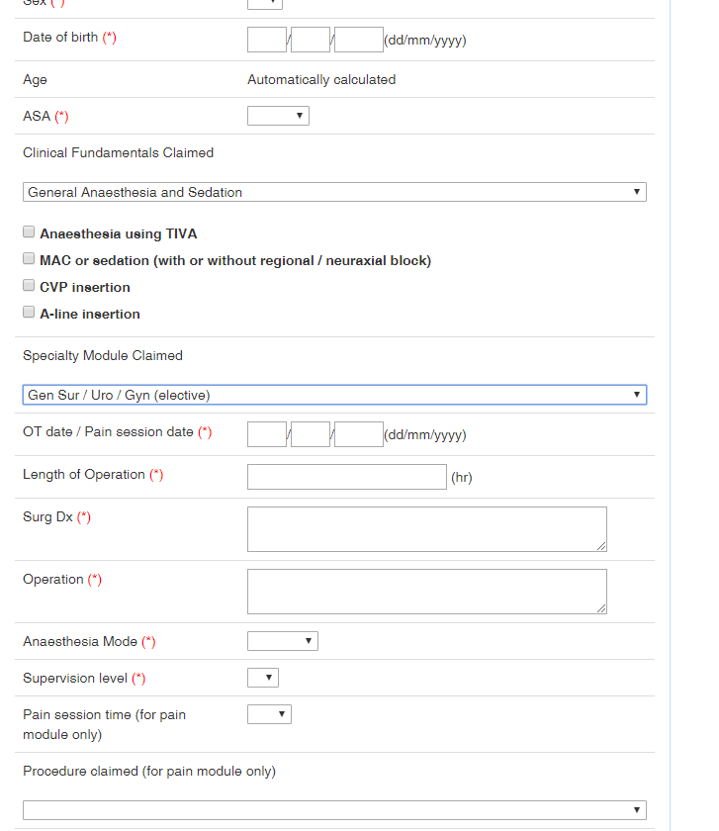
E-logbook
Notes:
For the e-logbook, we allow multiple entries for a single patient. For example, if you have a neurosurgical patient for decompressive craniectomy due to MCA infarct, you can claim TIVA, A-line and Central line insertion under clinical fundamental, as well as Neurosurgery under specialty module
The new curriculum has a new logbook entry system for the Pain Module. It requires both volume of practice and time session requirement (one needs 48 sessions to be completed in 6 months)

Slide 11
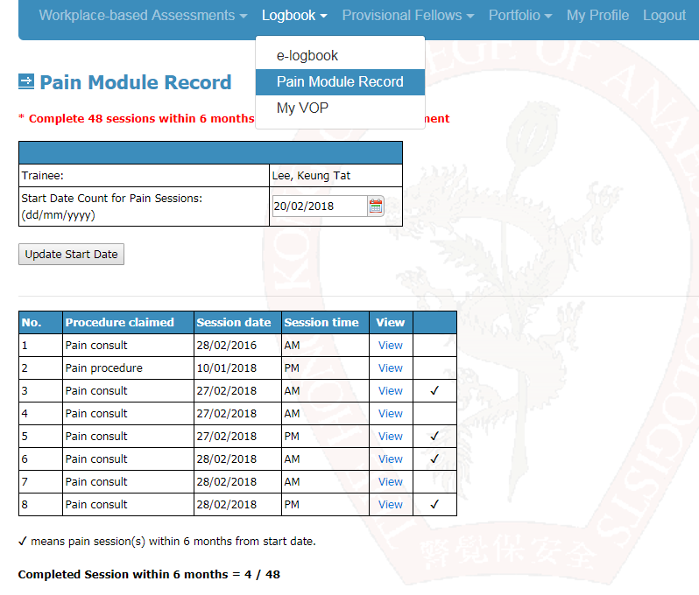
Pain module record
Notes:
We have a separate page to record all the activities done in the pain module
Since a trainee needs 48 consecutive sessions within a period of 6 months, they are allowed to change the start date of the pain module record. The recognized records will be represented by a “tick”
The trainee can view their progress at the bottom of the page

Slide 12
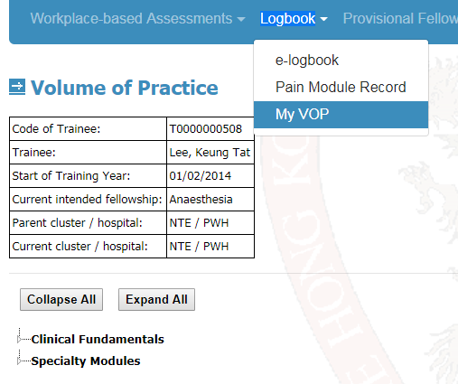
Notes:
My VOP allows a trainee to see the summary of the logbook

Slide 13
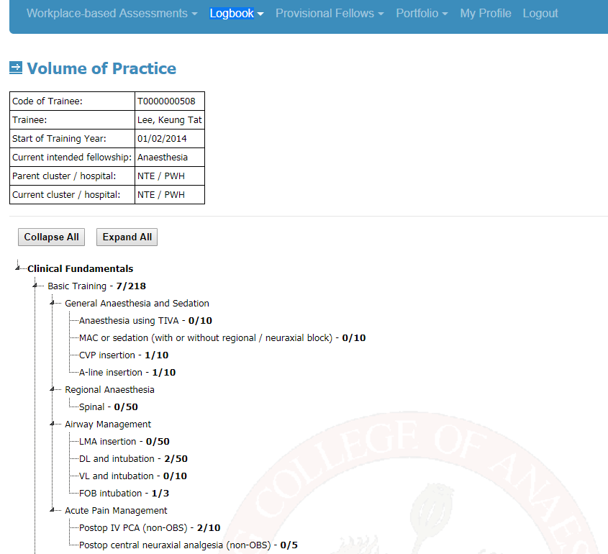
Notes:
Once you click “Expand All”, it allows you to see the progress at one goal
Each dot (as pointed by the small arrows) is a sub-heading. It allows you to expand and collapse the screen at this point for the ease of comprehension

Slide 14
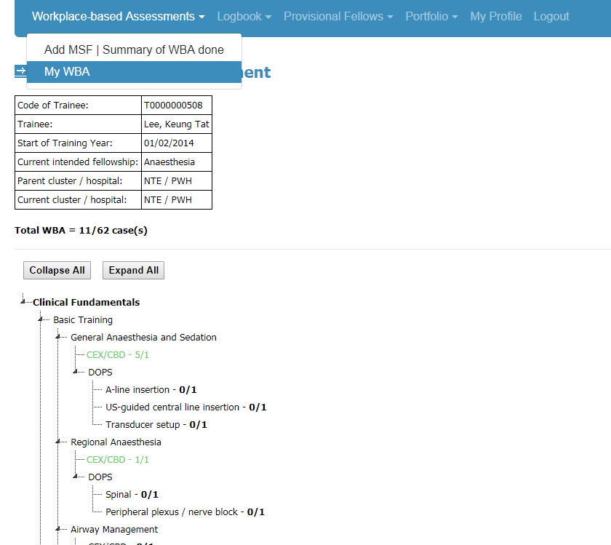
Notes:
Trainee can also view the progress of his/her WBA in individual items under the sub-heading “My WBA”
For both “My WBA” and “My VOP”, once an item is complete, it will turn green. This is for the ease of SOT to monitor someone’s progress

Slide 15
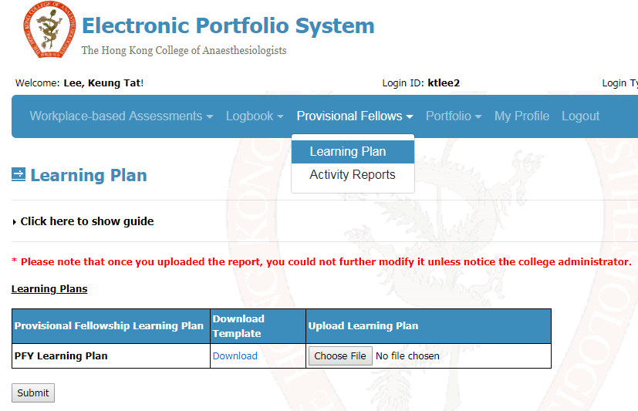
pfy
Notes:
For the provisional fellowship year, trainees are required to submit a learning plan before they enter the PFY and 3 activity reports during the PFY
Trainees can download the template from the above link to submit the plan to the SOT
The SOT can read the learning plan of the trainees in the same platform
If trainees are not sure about what to do with the learning plan, they can click onto “Click here to show guide”

Slide 16
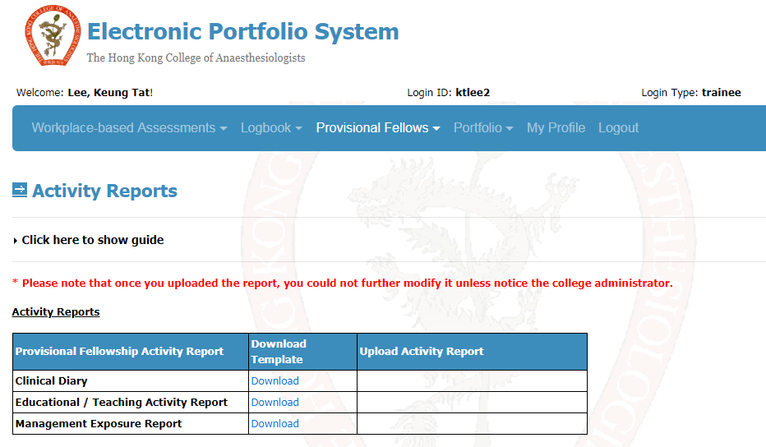
Notes:
The activity reports required are shown. Similarly, the trainees need to download the template to write the activity reports
The submitted and uploaded reports will be reviewed by the parent hospital SOT
The “Click hear to show guide” gives you instructions and explanations on what those reports are about

Slide 17
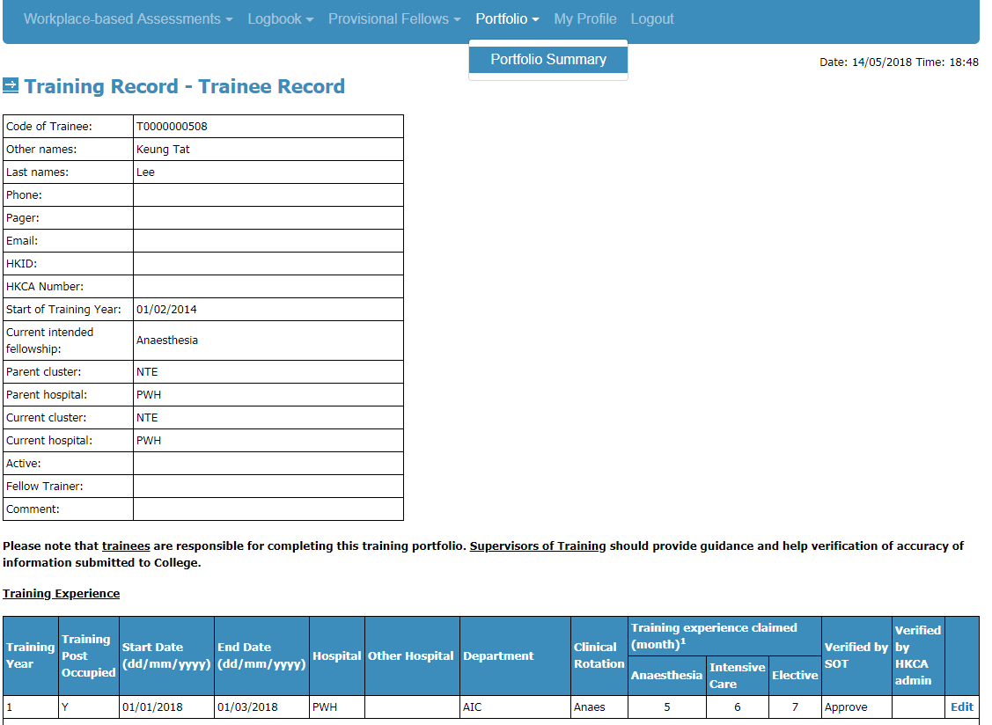
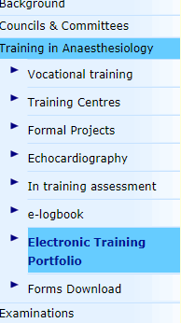
Portfolio summary
Notes:
The portfolio summary is almost the same as the old “e-training portfolio” we are using on College website
It shows one’s (1) training experience in Clinical Anaesthesia, ICU and Electives, (2) ITA, (3) mandatory courses attended and (4) formal project
PLEASE NOTE that a new ITA form is used for the new curriculum. You can click into the form to have a look

Slide 18
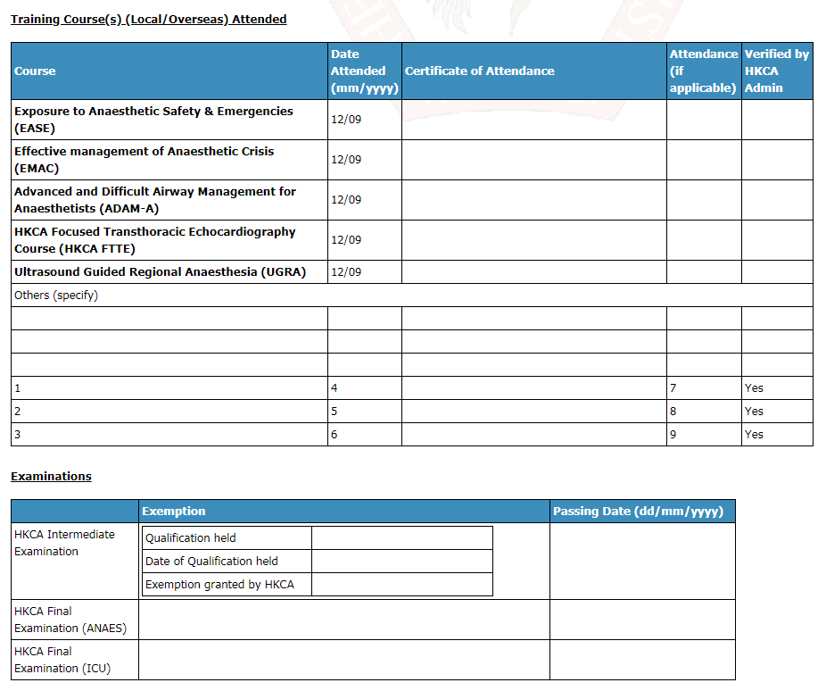
Portfolio summary
Notes:
In the new curriculum, we have 5 mandatory courses. Trainees are required to enter the date and upload electronic copy of the certificate attendance
The College will fill in the date of passing the professional exams

Slide 19
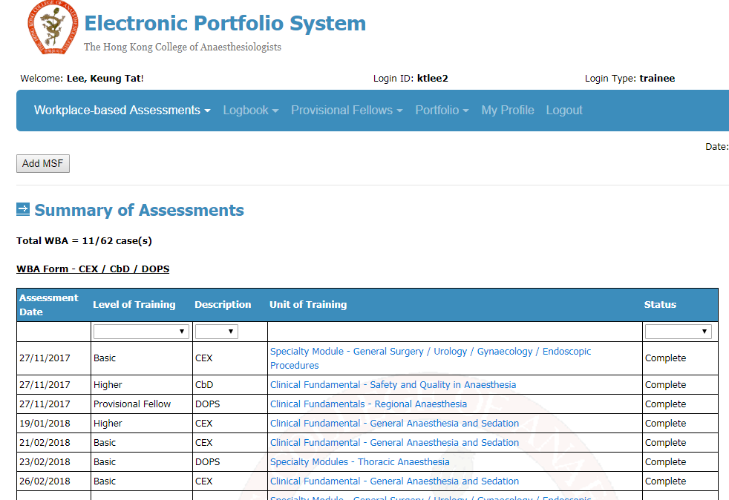
MSF
Notes:
The last function you need to know about is the multi-source feedback. We need 3 MSF throughout the training, one at each level of training
As SOT, we may prime the trainees to do MSF months before the end of each stage of training. It is the trainees who are responsible for “Add MSF” because they need to choose the sources and people to provide the feedback

Slide 20
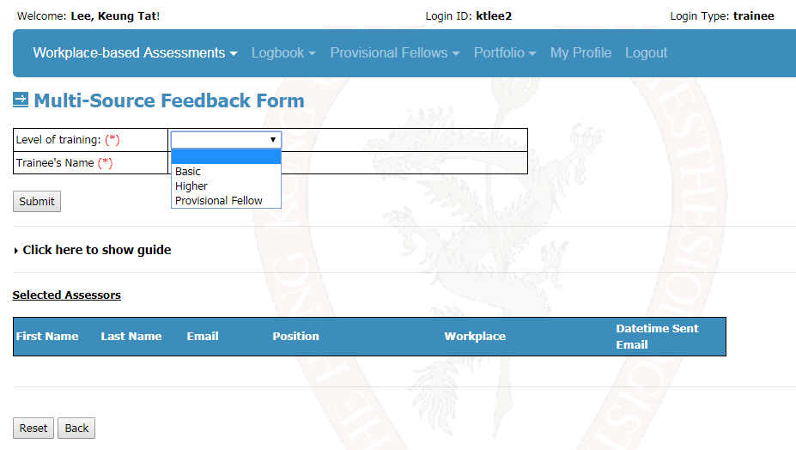
Notes:
After adding a MSF, trainees need to select the level of training and then submit the form
The guide has detailed explanation on the logistics in doing a MSF

Slide 21
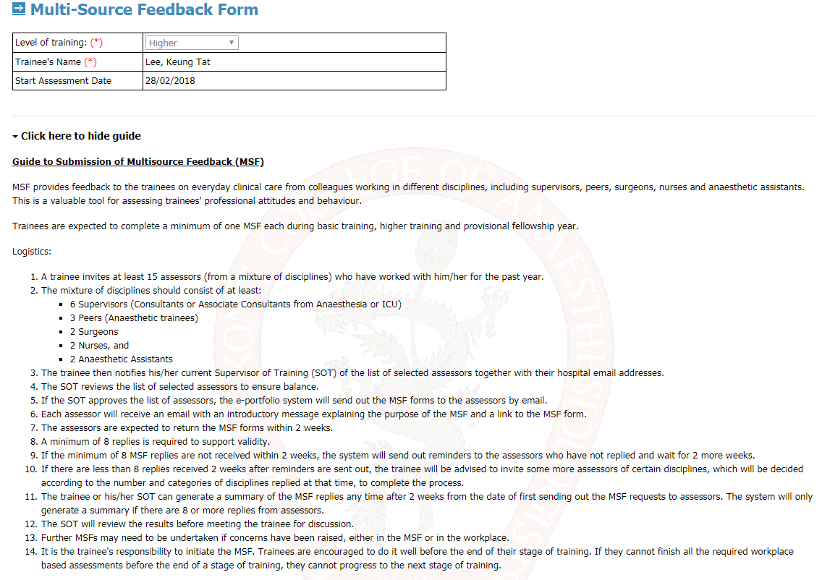

Slide 22
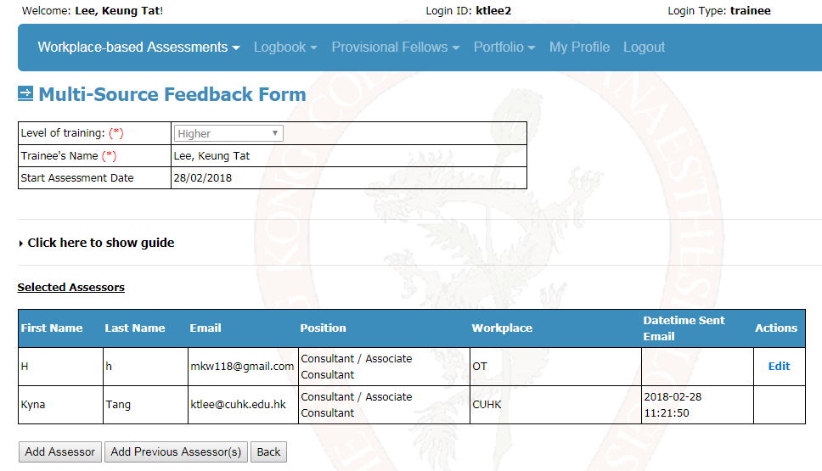
abc123
David
aa11
Notes:
After submitting the MSF form, trainees are required to provide a list of at least 15 assessors to do the MSF
SOT can see the same table in the SOT’s account. The selected assessors will be screened for validity. If ok, SOT will approve the assessors and email will be sent automatically to the assessor
A minimum of 8 replies is required
If there are less than 8 replies by 2 weeks, a reminder email will be sent again to the assessors and wait for another 2 weeks. If there are still less than 8 replies, the trainee will be asked to invite more assessors.

Slide 23
WHAT YOU NEED TO KNOW…
As a Trainer
As a Trainee
As a SOT
Your existing SOT login account is still valid for this electronic portfolio system
You can change your password after you log into the electronic portfolio system, under the session "My Profile" on the title bar

Slide 24
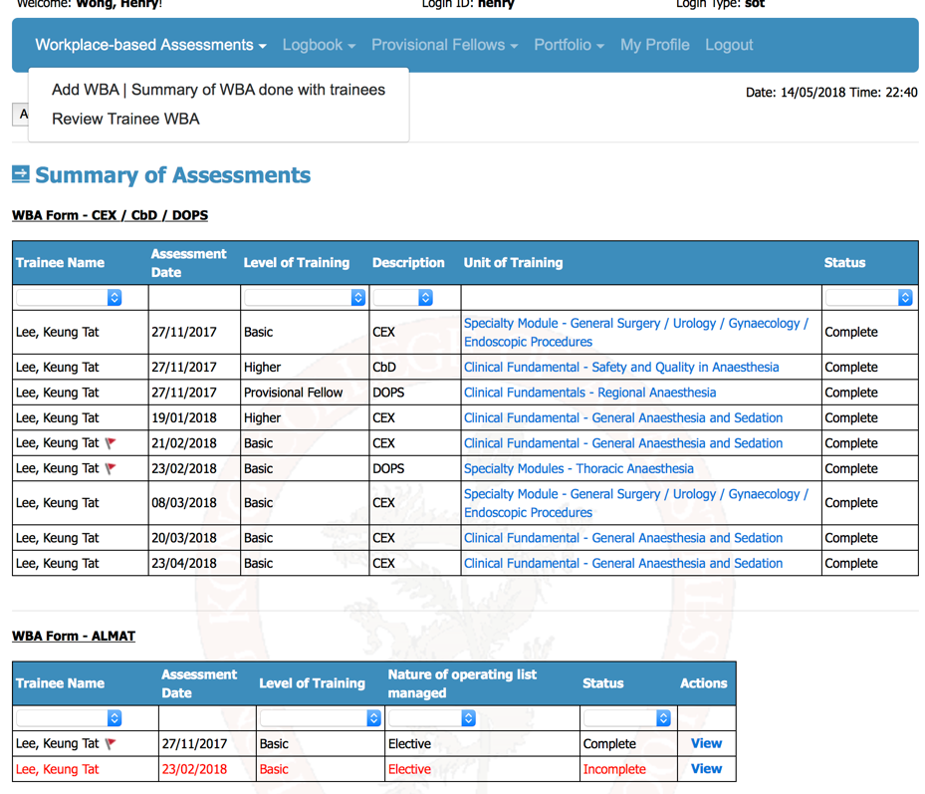
Sot
Notes:
The front page of the SOT account is the same as that of a trainer account. It shows the summary of the WBA done by you for the trainees
The SOT account has the access right to review the WBA done by all the other trainees (YELLOW ARROW)

Slide 25
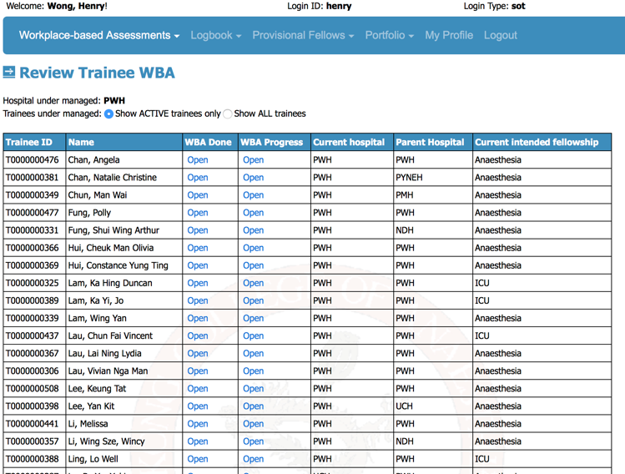
Trainee A
Trainee B
Trainee C
Trainee D
Trainee E
Trainee F
Trainee G
Trainee H
Trainee I
Trainee J
Trainee K
Trainee L
Trainee M
Trainee N
Trainee O
Trainee P
Trainee Q
Trainee R
Trainee S
Notes:
Once you click “Review Trainee WBA” under the heading “Workplace-based Assessments”, you will jump to this page
If you want to review all the WBA done for a particular trainee, either by you or by other trainers, click under “WBA done”. You can only view and modify your own WBA records, but not the WBA records submitted by the other trainers
If you want a summary or keep track of the WBA progress of a trainee, click “WBA progress”, a summary tree will show up (similar to “My WBA” in trainee’s account)

Slide 26
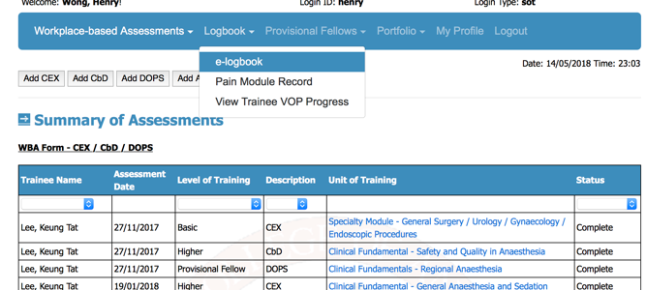
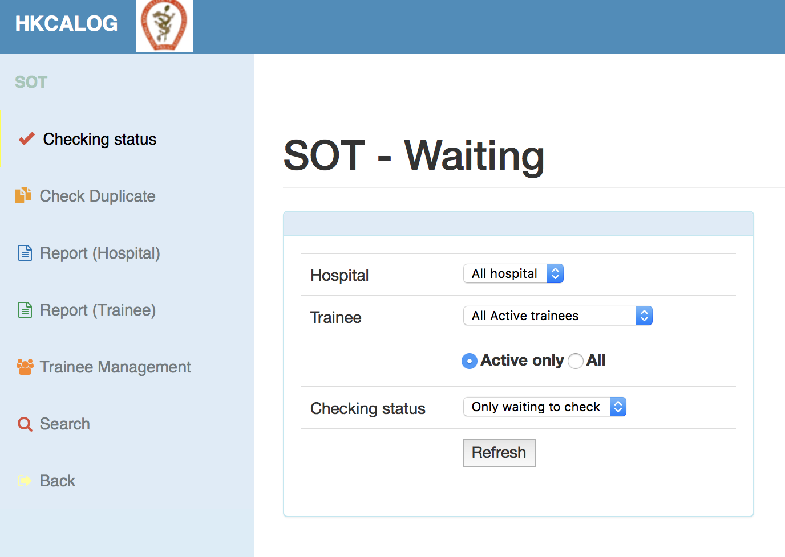
Notes:
The e-logbook for the SOT account has the same interface as the old one. SOT is able to view the details of the cases logged into the logbook.
If you just want to see the number of cases logged by a trainee in each category of the curriculum, click “View Trainee VOP Progress”. You will get a summary of the logbook in the format of a summary tree

Slide 27
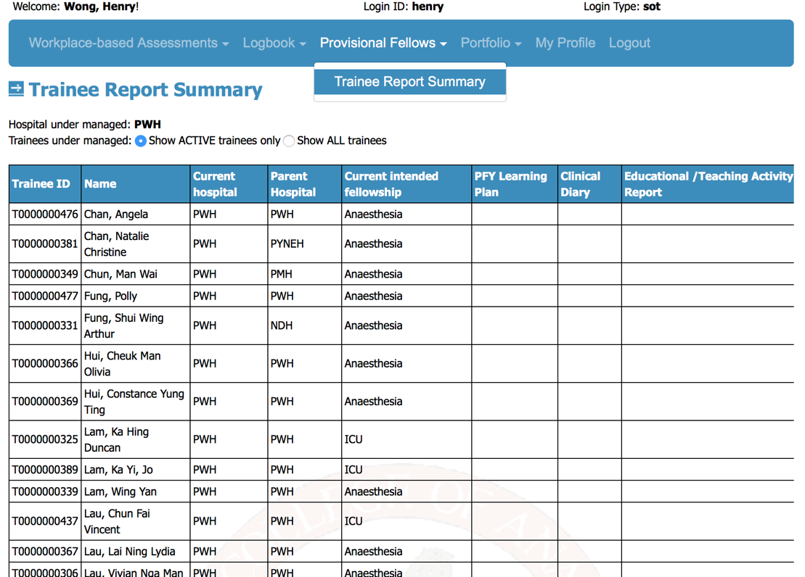
Trainee A
Trainee B
Trainee C
Trainee D
Trainee E
Trainee F
Trainee G
Trainee H
Trainee I
Trainee J
Trainee K
Trainee L
Trainee M
Notes:
1. Under the “Provisional Fellows”, SOTs are able to see the document uploaded by trainees, including the learning plan and all the activity reports required for the PFY

Slide 28
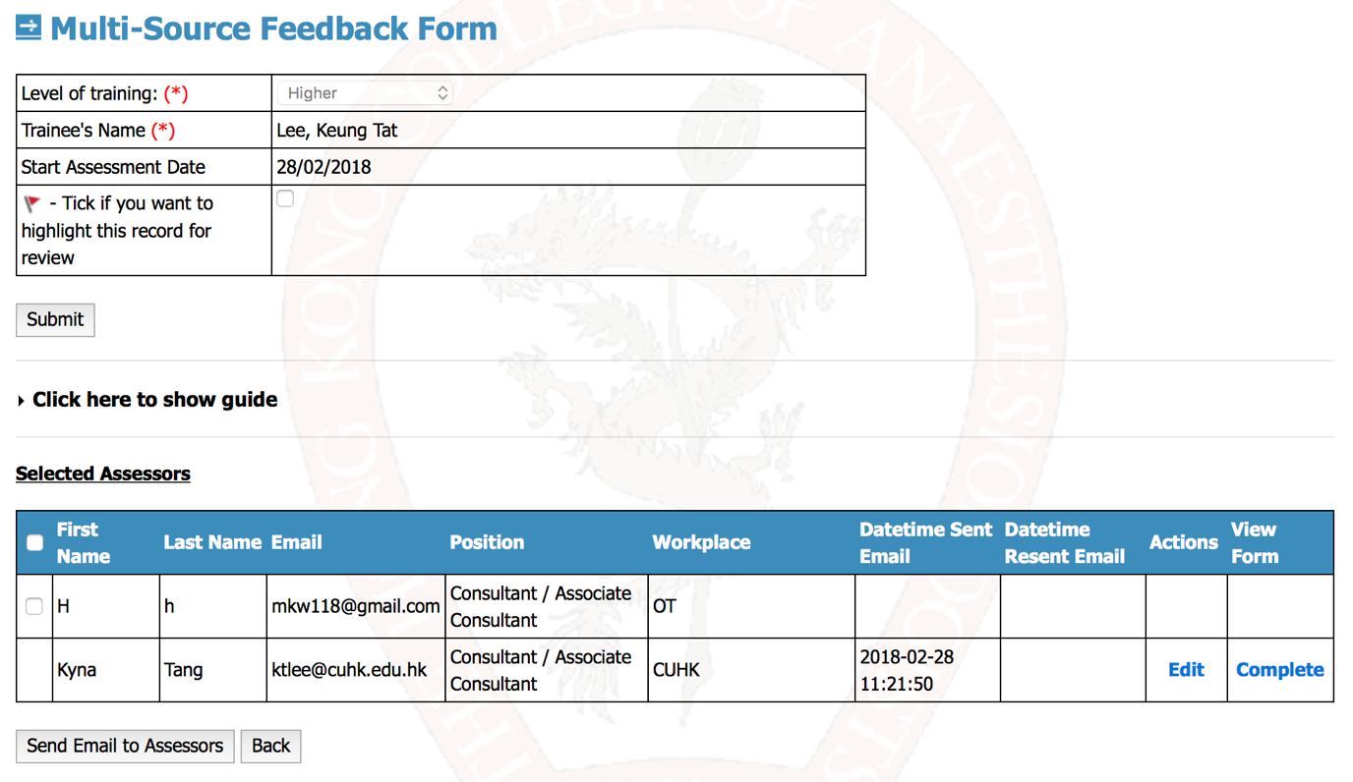
abc123
David
aa11@
Notes:
Back to Multi-source feedback function, once a trainee creates a MSF form and chooses the assessors, SOT has to review if the assessors are valid for MSF. If the selected assessors are suitable, click the box in RED CIRCLE to select the assessor. An email template will be sent to invite him/her to do a MSF form for that particular trainee
After the assessor submits the form, you can see “Complete” in the table (RED ARROW)
If no reply from an assessor in 2 weeks’ time, a reminder will be sent automatically by the system
A minimum of 8 replies is required

Slide 29
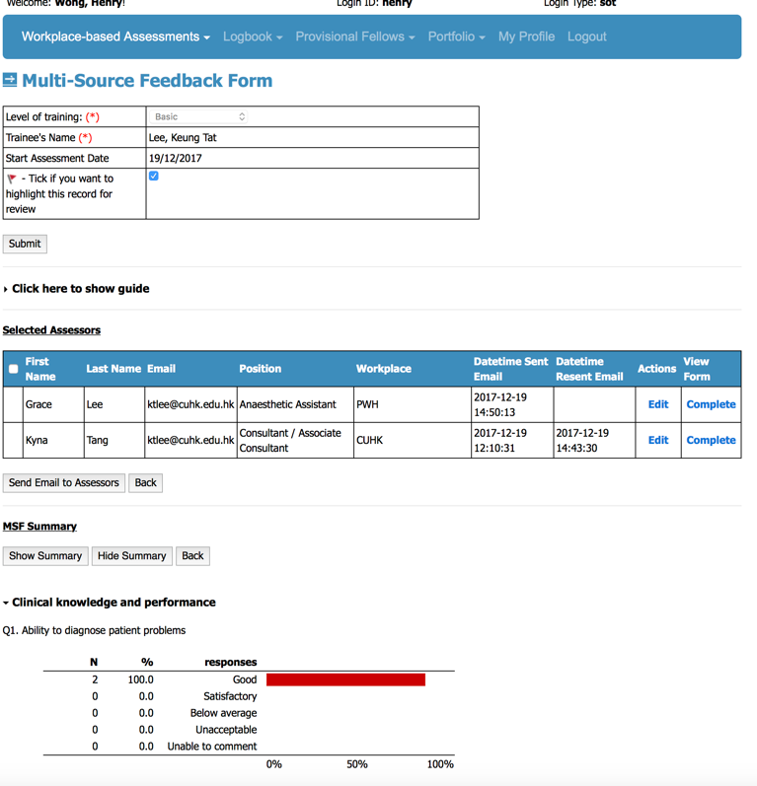
Notes:
The system can generate statistics to each question asked in the MSF form, in the format of a bar chart
A minimum of 8 replies is required for the system to generate the statistics. This is because a minimum of 8 replies is required by the College for the MSF to be valid
Only SOT account has the access right to generate the statistics. You can sit together with the trainees and show him/her the charts

